Slide 1




MBC 638:
Data Analysis & Decision Making
Anna Chernobai
Lecture 09:
Normal distribution (Chapter 5)
Notes:
Chernobai

Slide 2
Today: Normal distribution
Normal distribution: properties
Normal distribution: examples
MBC638-Chernobai
Lecture 09

Slide 3

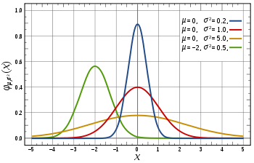
1. Normal distribution: properties
2 parameters
Density of N(μ, σ):
MBC638-Chernobai
Lecture 09

Slide 4
1. Normal distribution: properties
Is a continuous distribution.
  X can take values from -∞ to +∞.
Has 2 parameters that fully characterize it:
μ (=mean) and σ (=standard deviation).
Notations: N(μ,σ) = Normal distribution with mean equal to μ and standard deviation equal to σ.
When it is used? To model data that is unimodal and roughly symmetric, i.e., bell-shaped. Most common applications in business: stock returns, portfolio returns. Other: person’s heights, weights…
MBC638-Chernobai
Lecture 09

Slide 5
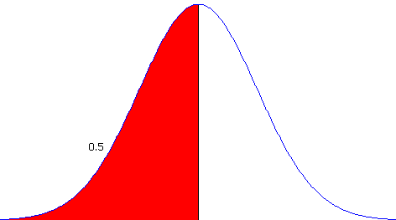
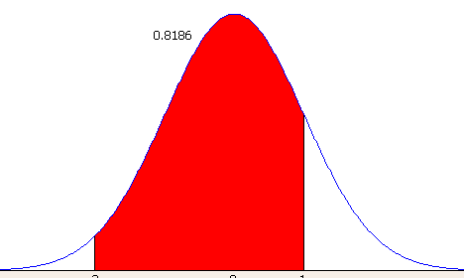
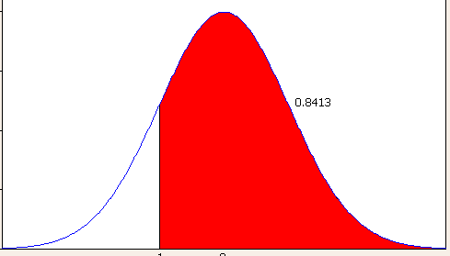
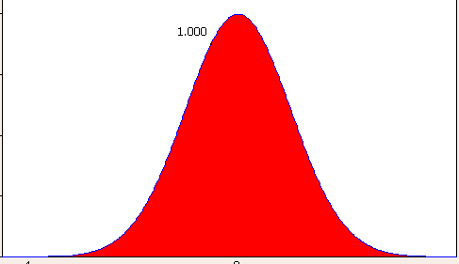
1. Normal distribution: properties
P (X < μ ) = P(X > μ) = 0.5
by symmetry
μ
P (A < X < B ) = P (X<B) – P(X<A)
P (A ≤ X ≤ B ) = P (X<B) – P(X<A)
because Normal distribution is continuous
A B
P (X > C ) = 1 – P(X<C)
complements
C
Total area under the curve = 1.
MBC638-Chernobai
Lecture 09

Slide 6
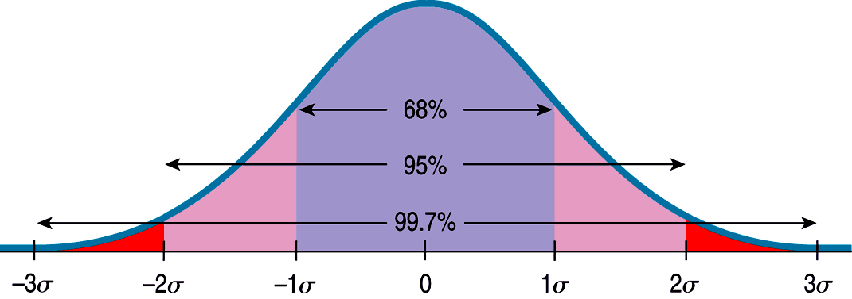
1. Normal distribution: properties
Since Normal distribution is bell-shaped and symmetric,
the Empirical Rule holds perfectly.
μ
μ
μ
μ
μ+
μ+
μ+
MBC638-Chernobai
Lecture 09

Slide 7
1. Normal distribution: properties
  Normal distribution in Excel:
  To find cumulative probability P(X < k):
    = NORM.DIST(k, μ, σ, TRUE)
    or = NORM.DIST(k, μ, σ, 1)
  To find a percentile of the distribution, i.e., find k so that P(X < k) = p:
  = NORM.INV(p, μ, σ)
MBC638-Chernobai
Lecture 09

Slide 8
1. Normal distribution: properties
A very useful property of Normal distribution:
A sum of two or more independent Normal variables is also Normally distributed.
  X₁~N(μ₁, σ₁)
  X₂~N(μ₂, σ₂)
  X₁ and X₂ are independent
  Then their sum:
Y=X₁+X₂ ~ N(μ₁+μ₂, √σ²₁ + σ²₂)
MBC638-Chernobai
Lecture 09

Slide 9
Today: Normal distribution
Normal distribution: properties
Normal distribution: examples
MBC638-Chernobai
Lecture 09

Slide 10
2. Normal distribution: examples
Example
An average credit card debt amount of freshmen students is $3,000 a year. The standard deviation is $500. Assume that the credit card amounts follow a bell-shaped normal distribution.
What is the probability that a randomly selected SU freshman student has accumulated under $3,800 in credit card debt?
What is the probability that a randomly selected SU freshman student has accumulated over $3,800 in credit card debt?
What is the probability that among any 3 random SU students, at least one would have over $3,800 in credit card debt?
MBC638-Chernobai
Lecture 09

Slide 11
2. Normal distribution: examples
Example
The weekly demand for Ford car sales follows a normal distribution with mean 50,000 cars and a standard deviation of 14,000 cars.
What is the probability that Ford will sell between 2.4 and 2.7 million cars during the next year? (Assume that weekly demands are independent.)
Ford is confident that there is only a 1% chance that it will sell less than what number of cars during the next year?
5% of the time, Ford sells more than what number of cars during the year?
Recall: A sum of 2 or more Normally distributed random variables is also Normal.
MBC638-Chernobai
Lecture 09

Slide 12
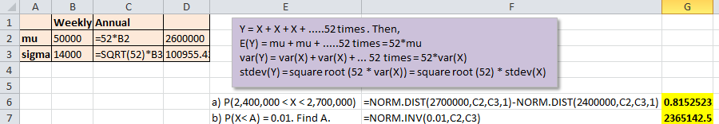
2. Normal distribution: examples
Example - solutions
The weekly demand for Ford car sales follows a normal distribution with mean 50,000 cars and a standard deviation of 14,000 cars.
What is the probability that Ford will sell between 2.4 and 2.7 million cars during the next year? (Assume that weekly demands are independent.)
Ford is confident that there is only a 1% chance that it will sell less than what number of cars during the next year?
MBC638-Chernobai
Lecture 09
In Excel:

Slide 13
2. Normal distribution: examples
Example
You are holding an equal-weighted portfolio of two stocks, Apple and IBM, with respective average returns of 10% and 8% and standard deviations of 4% and 3%.
Assume that the two stock returns are Normally distributed and are independent (in reality, this independence assumption is unrealistic!).
Find the probability that your portfolio’s return exceeds 15%.
Recall: A sum of 2 or more Normally distributed random variables is also Normal. Hence, a weighted sum is also Normal.
http://planetmath.org/sumsofnormalrandomvariablesneednotbenormal
MBC638-Chernobai
Lecture 09

Slide 14
2. Normal distribution: examples
Example
A used-car dealership has found that, for the cars it sells, the length of time before a major repair is required is normally distributed with a mean of 10 years and a standard deviation of 3 years.
The dealer needs to decide what guarantee time to specify for the cars he sells.
Clearly, he doesn’t want it to be too low (no one would buy his cars) or too high (if a car fails, he’ll have to pay for the repairs).
The dealer wants no more than 5% of the cars to fail before guarantee time (then, his costs would be low).
What is the optimal guarantee time?
MBC638-Chernobai
Lecture 09

Slide 15

Today: Normal distribution
Normal distribution: properties
Normal distribution: examples
MBC638-Chernobai
Lecture 09

